Slide 1
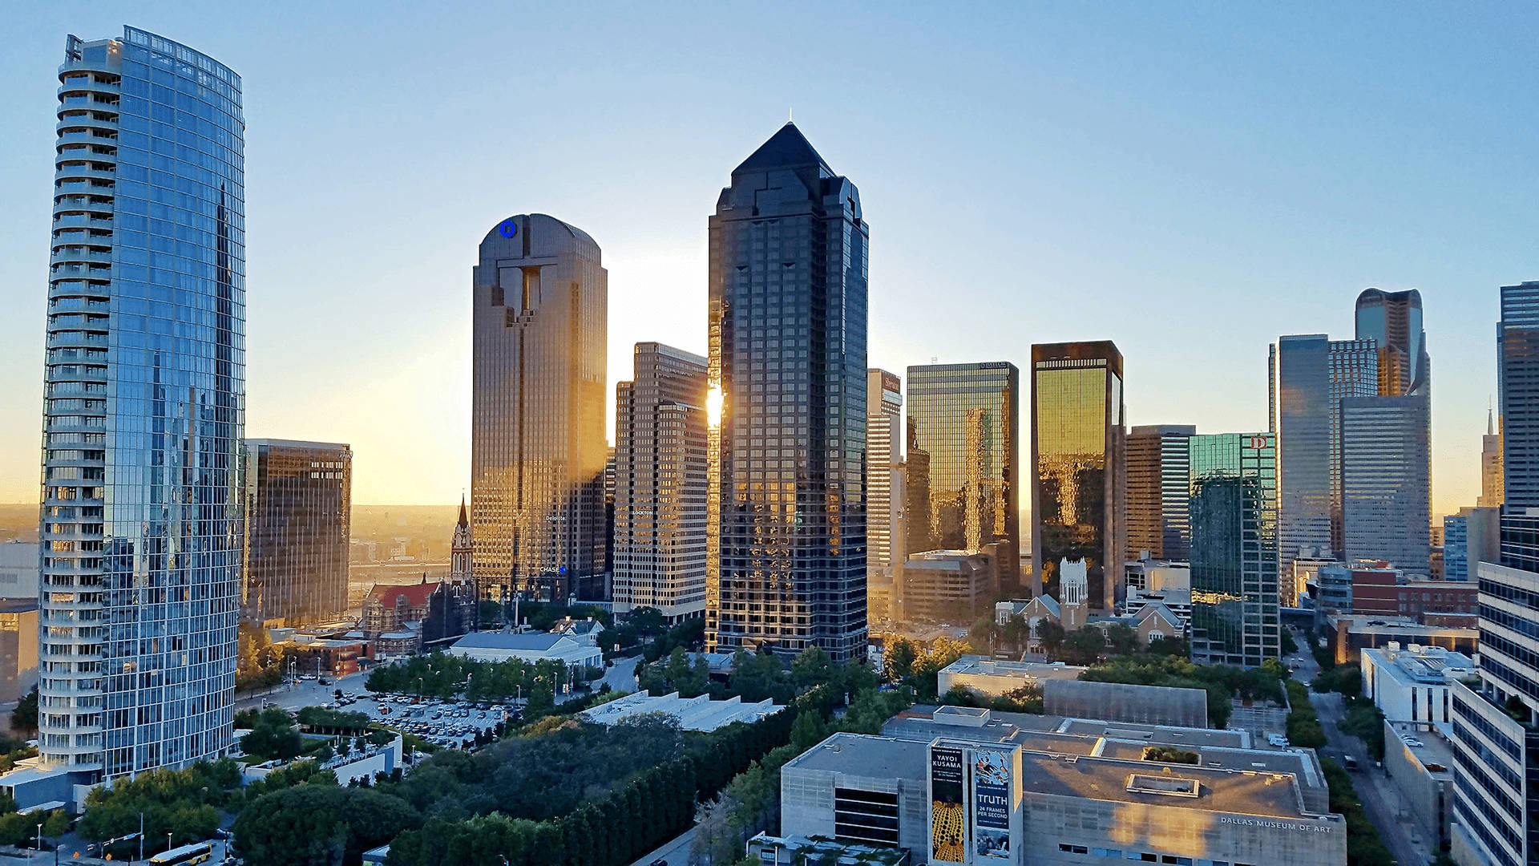

Real Estate Marketing Website with AI
Supervisor:
Dr. Rania Rajab
Student Names:
Fahad Abdulrahman Naji
Baraa Mujahid

Slide 2
Project importance
1. Developing a real estate management data site.
2. Improved user experience with a user-friendly interface
3. Enabling intermediaries and developers to reach a wider audience.

Slide 3
Project goals
Aqari provides an intermediary platform between buyers and property owners, with multiple features such as property listings via a slider, competitive offers, a seamless search experience, user management, property management, and the ability for users to submit complaints. Browse properties, view complaints, access the welcome page, view statistics, connect with others, add a favorites page, share properties, find frequently asked questions, and filter searches.

Slide 4
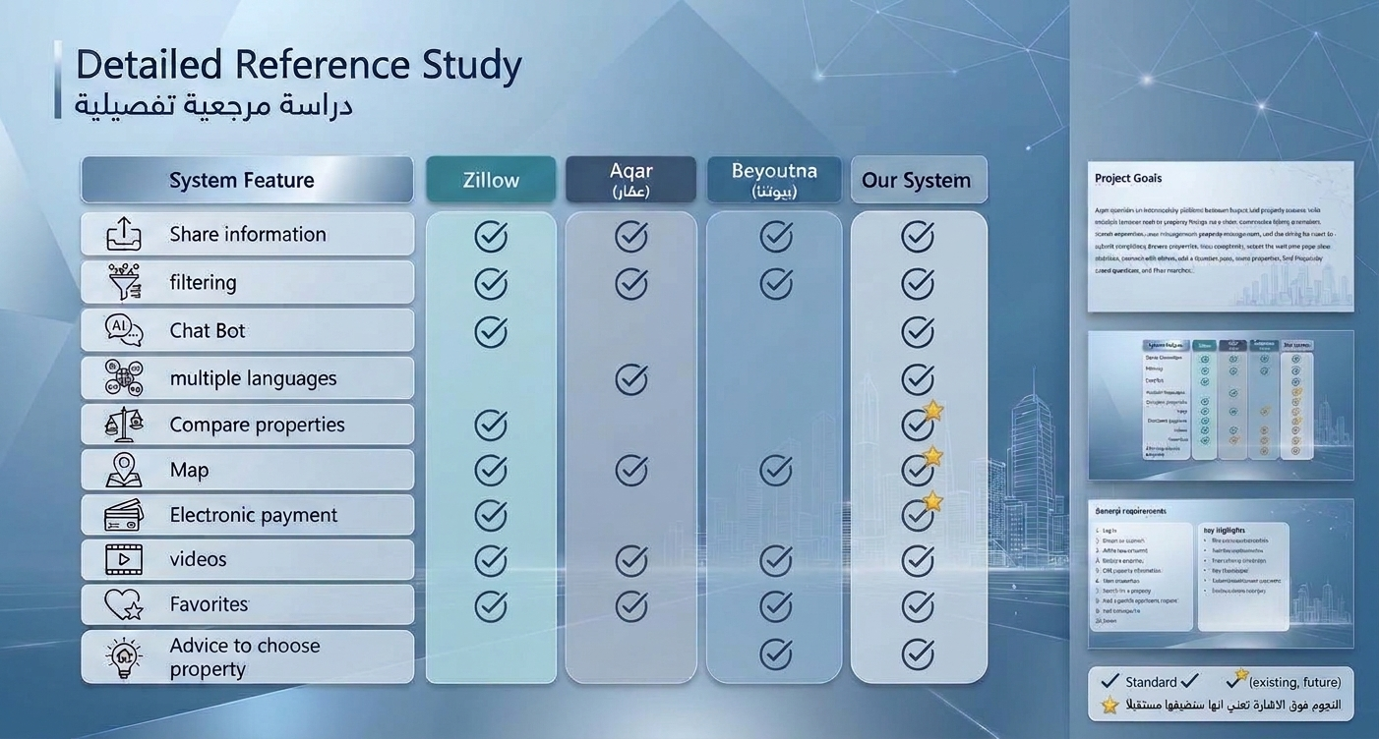

Slide 5
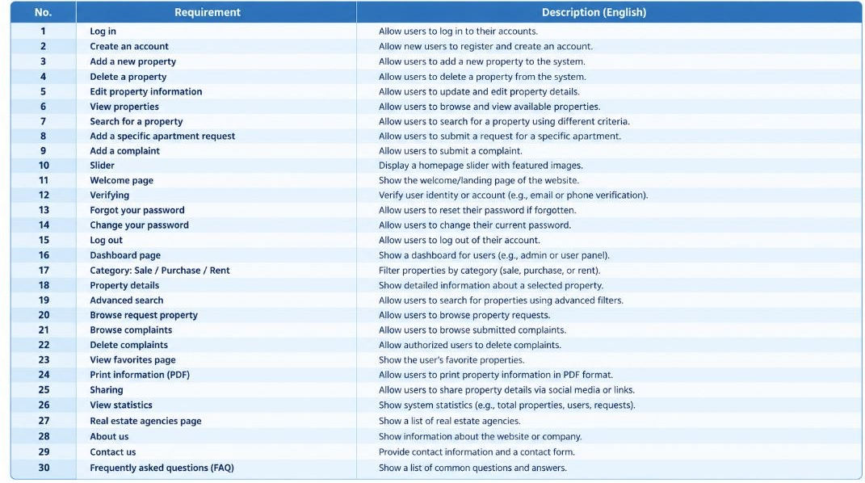
General requirements

Slide 6
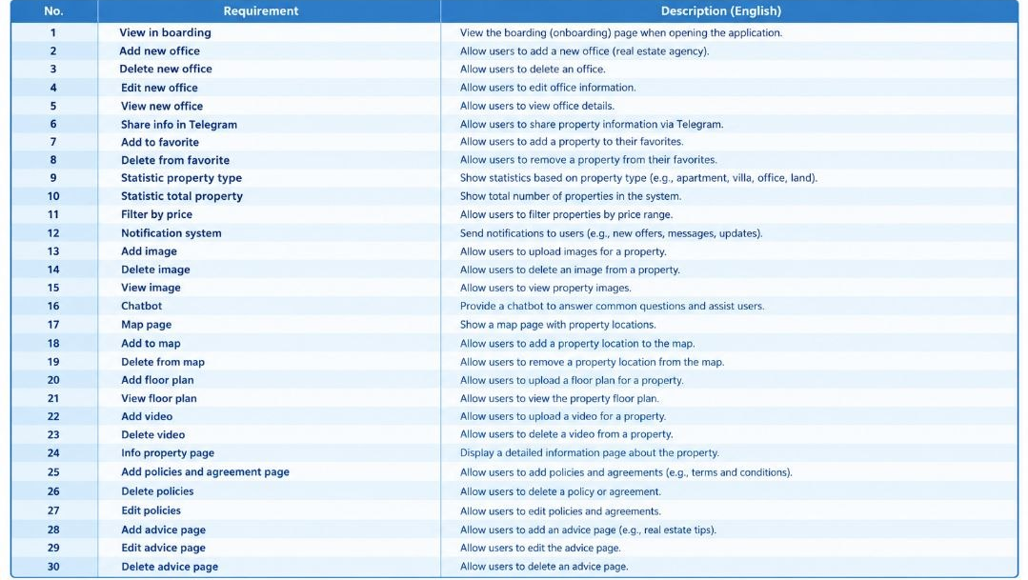
Requirements

Slide 7
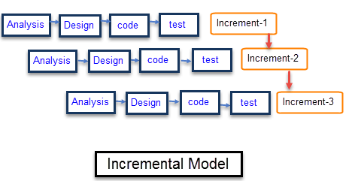
methodology :
Incremental model
The project is divided into smaller parts,
which are developed and delivered sequentially, with each part adding new functionality to the previous version until the product is fully complete.

Slide 8
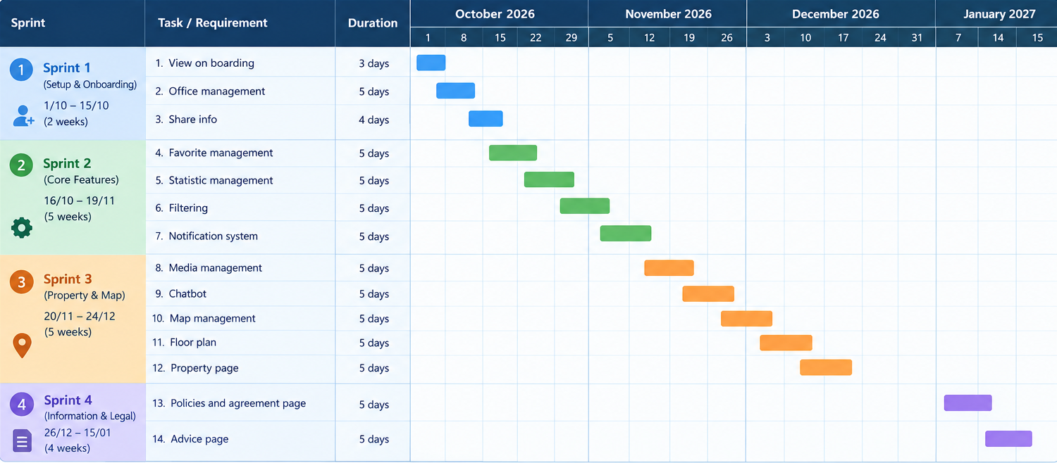
Project plan-Gantt Chart
7
7

Slide 9
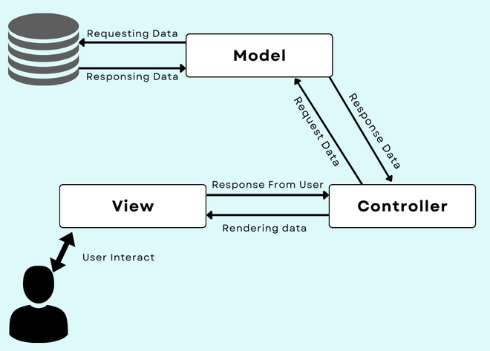
Software Architecture
MVC / Client-server

Slide 10
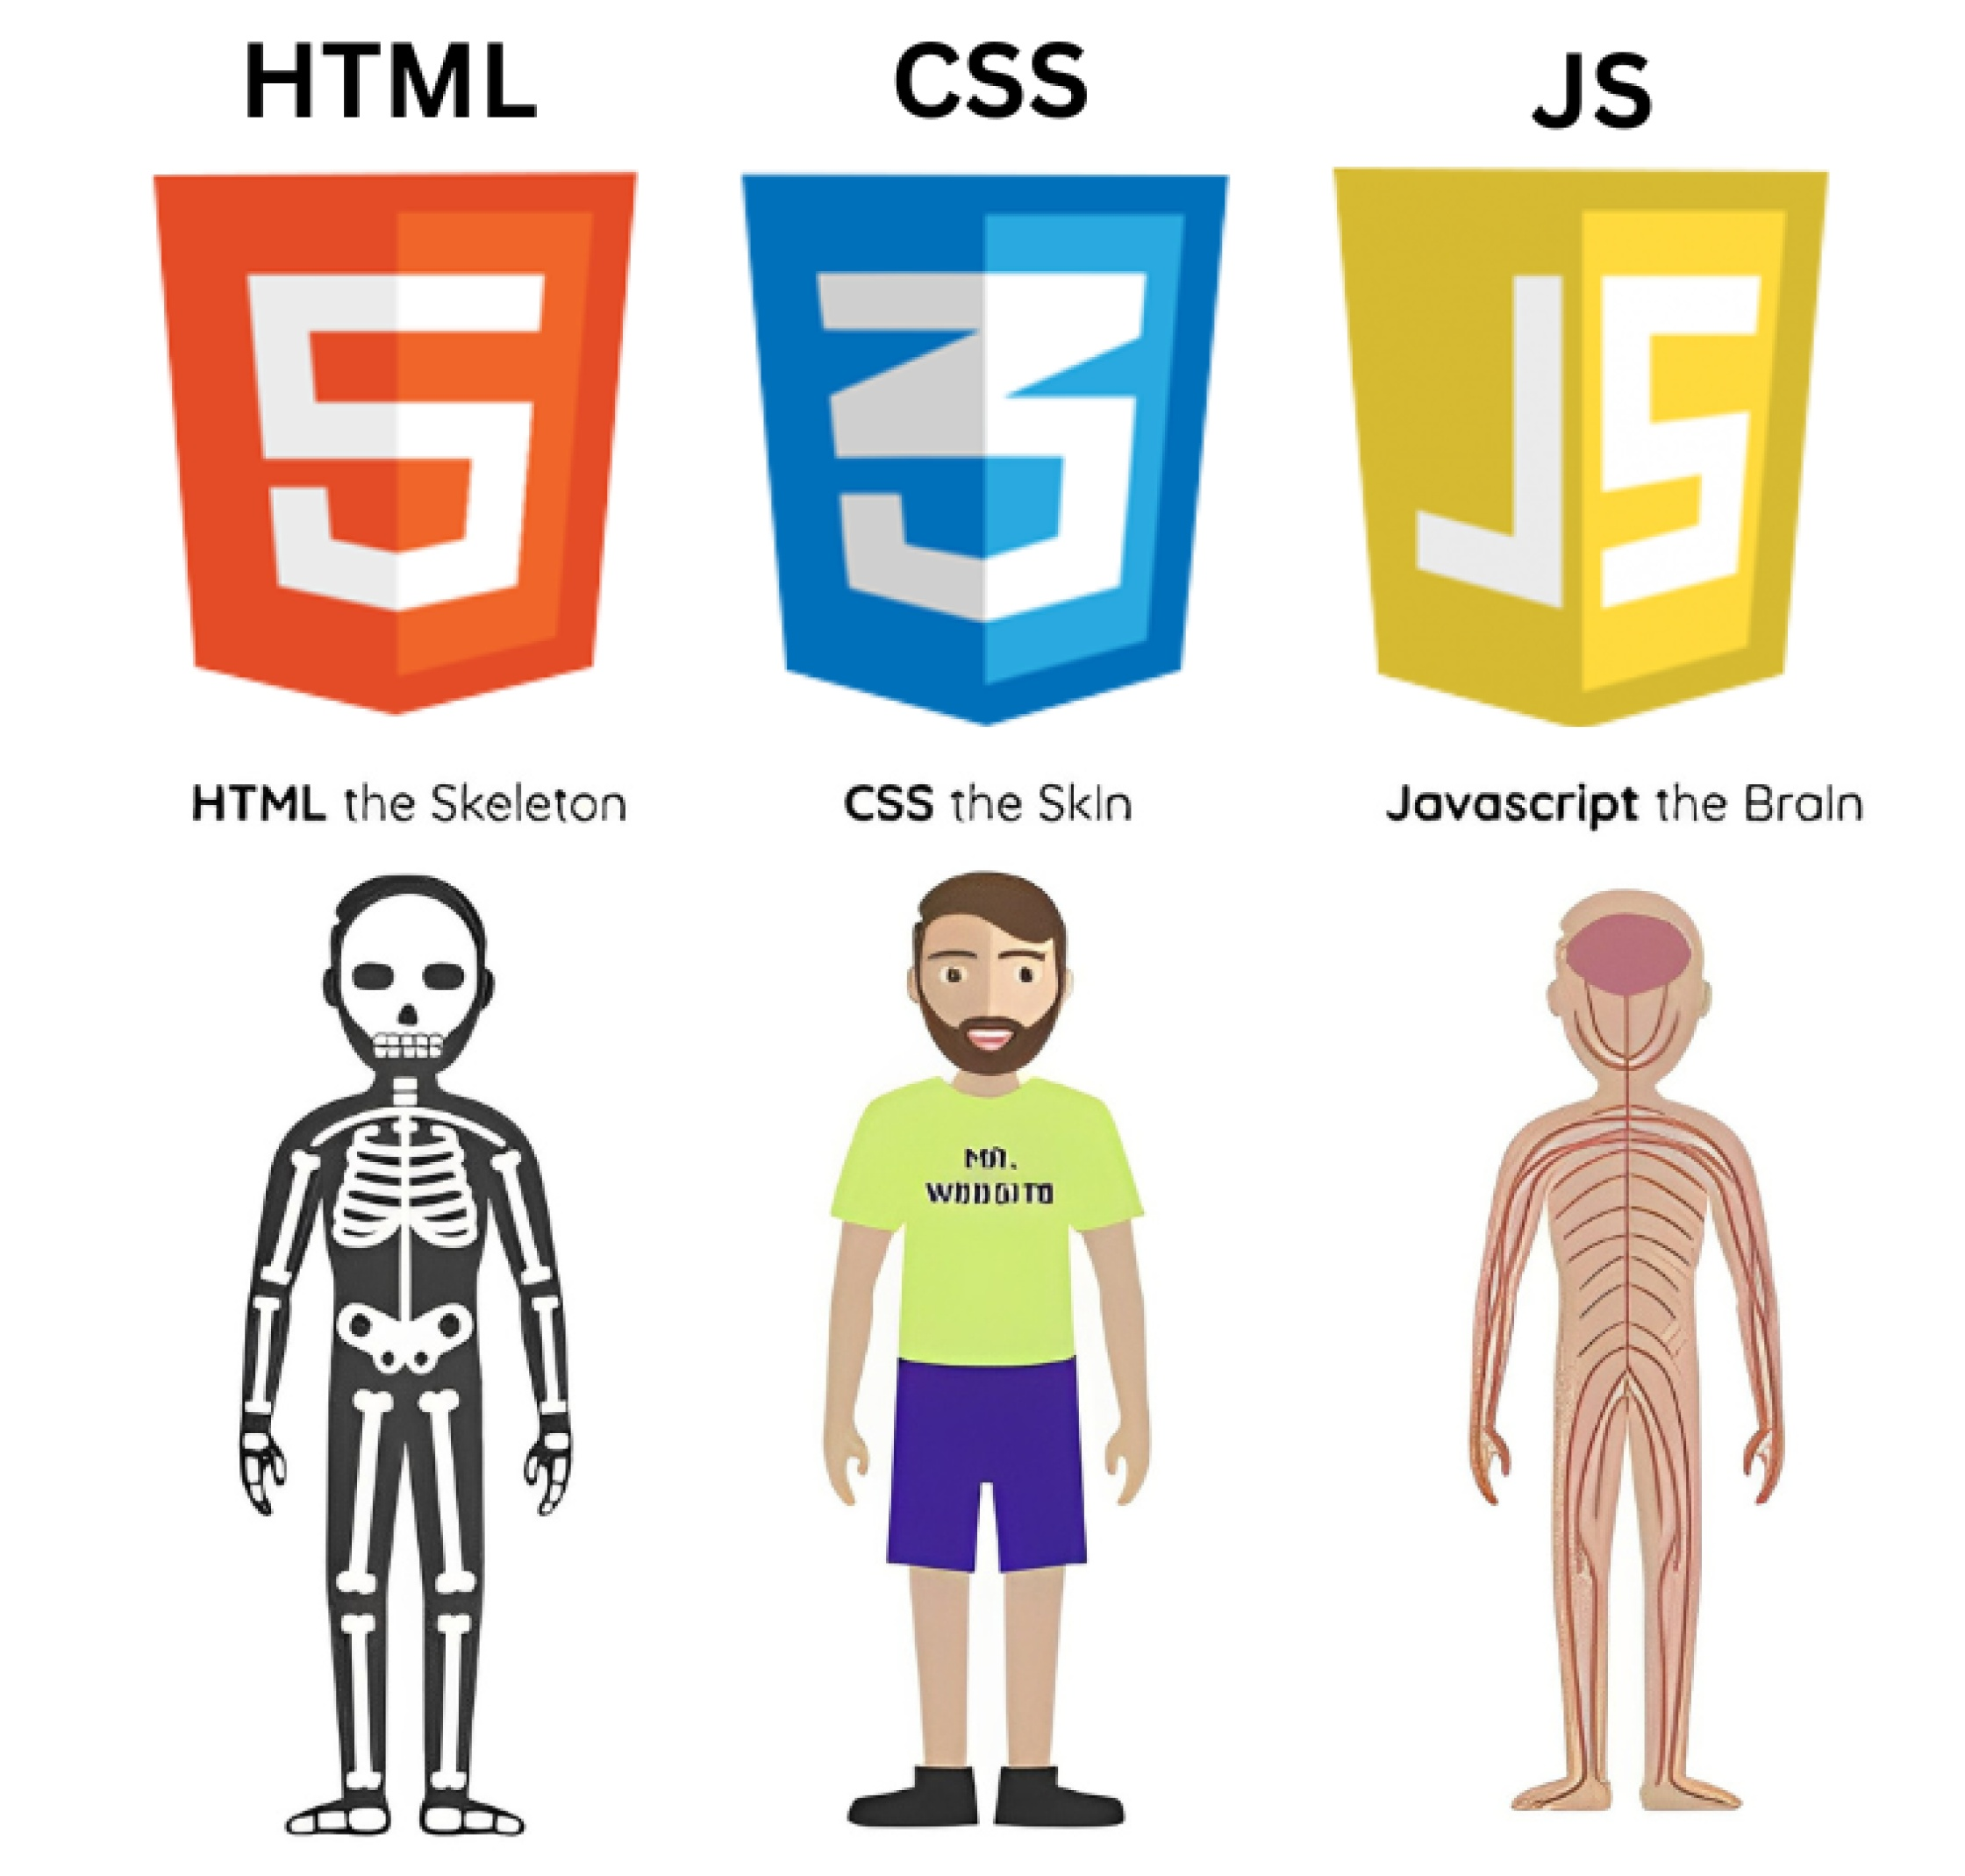
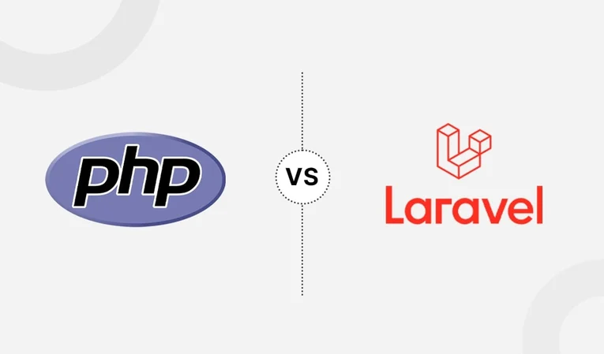
Tools:
Front end: HTML, CSS , JS , bootstrap
Back end: php Laravel
Database: MySQL

Slide 11
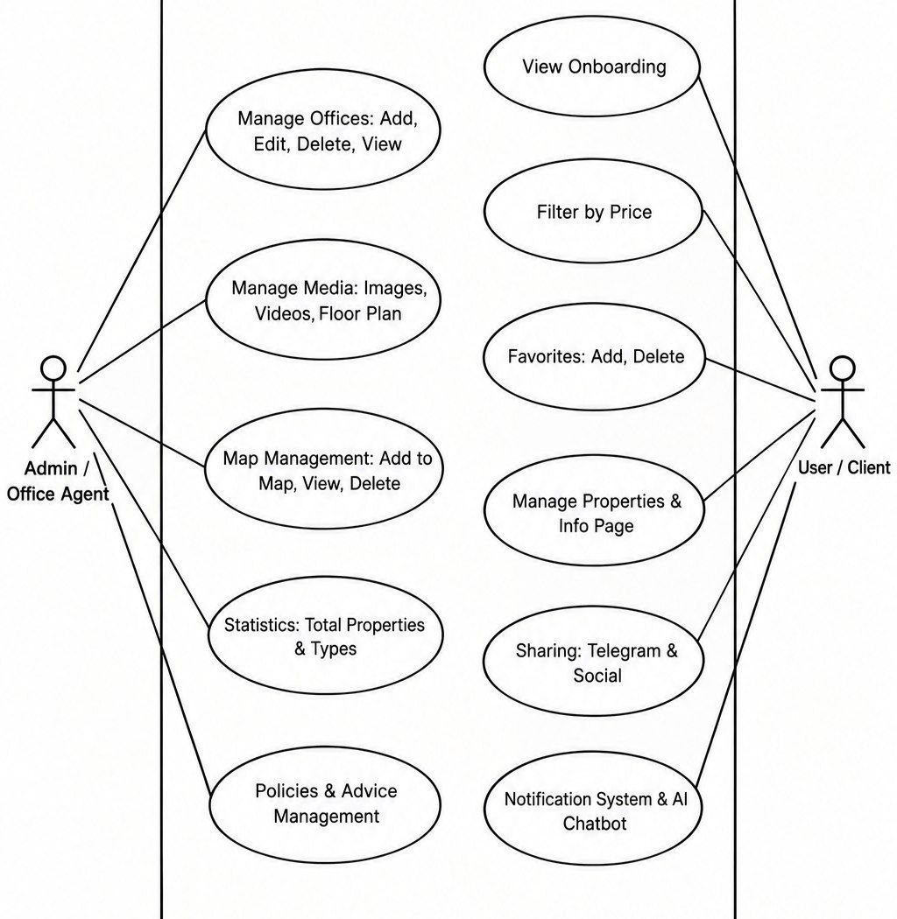
low level-Use Case:

Slide 12
Thank you

